Slide 1
ECE 532
CHAPTER 1: REVISION OF COMPUTER PROGRAMMING CONCEPT: STRUCTURE
Lecturer: Dr. Roslina Mohamad
Room: Tower 2, Level 13, No:14C

Slide 2


Slide 3

Learning Outcomes
At the end of this lecture, you will be able to:
Understand about records (structs)
Examine various operations on a struct
Explore ways to manipulate data using a struct
Discover how arrays and pointers are used in a struct

Slide 4
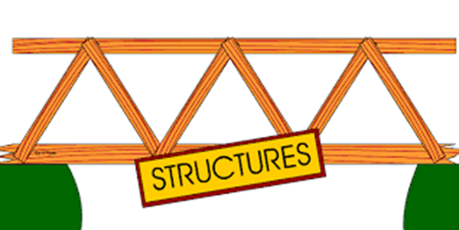
Structures
Structure: Programmer-defined data type that allows multiple variables to be grouped together
Members may be of different types
Structure Declaration Format:
struct structure name
{
type1 field1;
type2 field2;
…
typen fieldn;
};

Slide 5
Example struct Declaration
struct Student
{
int studentID;
string name;
short year;
double gpa;
};
structure name
structure members
Notice the required ;

Slide 6


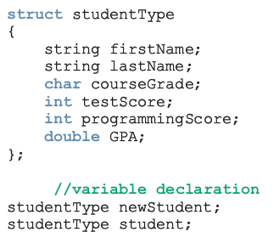

(structs)
A struct is a definition, not a declaration

Slide 7
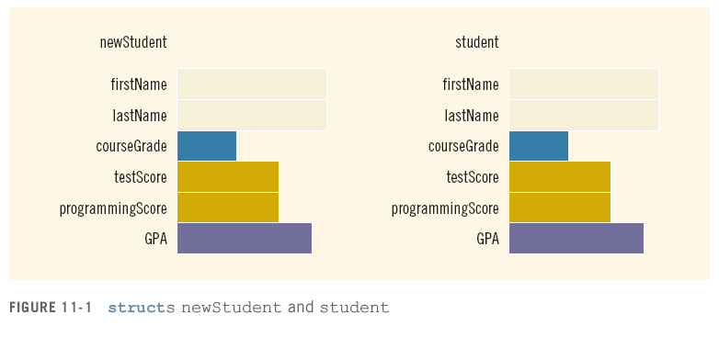
(structs)

Slide 8
Defining Structure Variables
struct declaration does not allocate memory or create variables
To define variables, use structure tag as type name
Student_UITM s1;
s1
studentID
name
year
gpa

Slide 9
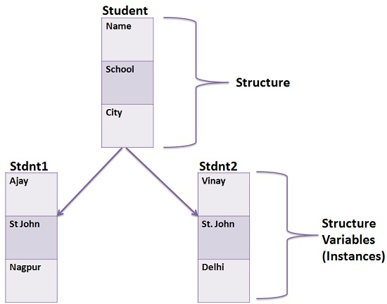
Accessing struct Members
The syntax for accessing a struct member is:
The dot (.) is an operator, called the member access operator
getline(cin, s1.name);
cin >> s1.studentID;
s1.gpa = 3.75;
Member variables can be used in any manner appropriate for their data type

Slide 10
Input/Output
No aggregate input/output operations on a struct variable
Data in a struct variable must be read one member at a time
The contents of a struct variable must be written one member at a time

Slide 11

Displaying struct Members
To display the contents of a struct variable, you must display each field separately, using the dot operator
Wrong:
cout << s1; // won’t work!
Correct:
cout << s1.studentID << endl;
cout << s1.name << endl;
cout << s1.year << endl;
cout << s1.gpa;

Slide 12

Assignment
Value of one struct variable can be assigned to another struct variable of the same type using an assignment statement
The statement:
student = newStudent;
copies the contents of newStudent into student

Slide 13
Assignment
The assignment statement:
student = newStudent;
is equivalent to the following statements:
student.firstName = newStudent.firstName;
student.lastName = newStudent.lastName;
student.courseGrade = newStudent.courseGrade;
student.testScore = newStudent.testScore;
student.programmingScore = newStudent.programmingScore;
student.GPA = newStudent.GPA;

Slide 14
Accessing struct Members
More examples:
cin >> newStudent.firstName;
cin >> newStudent.testScore >> newStudent.programmingScore;
score = (newStudent.testScore + newStudent.programmingScore) / 2;

Slide 15
Accessing struct Members
if (score >= 90)
newStudent.courseGrade = 'A';
else if (score >= 80)
newStudent.courseGrade = 'B';
else if (score >= 70)
newStudent.courseGrade = 'C';
else if (score >= 60)
newStudent.courseGrade = 'D';
else
newStudent.courseGrade = 'F';

Slide 16
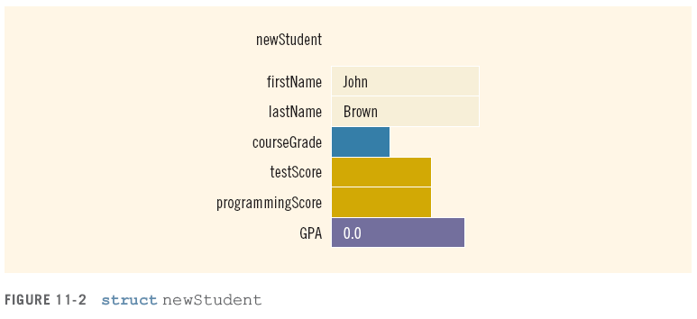
Accessing struct Members
To initialize the members of newStudent:
newStudent.GPA = 0.0;
newStudent.firstName = "John";
newStudent.lastName = "Brown";

Slide 17
Example
Example 1.13
Example 1.14

Slide 18
Comparing struct Members
Similar to displaying a struct, you cannot compare two struct variables directly:
if (s1 >= s2) // won’t work!
Instead, compare member variables:
if (s1.gpa >= s2.gpa) // better

Slide 19
Initializing a Structure
Cannot initialize members in the structure declaration, because no memory has been allocated yet
struct Student // Illegal
{ // initialization
int studentID = 1145;
string name = "Alex";
short year = 1;
float gpa = 2.95;
};

Slide 20
Initializing a Structure
Structure members are initialized at the time a structure variable is created
Can initialize a structure variable’s members with either
an initialization list
a constructor

Slide 21
Using an Initialization List
An initialization list is an ordered set of values, separated by commas and contained in { }, that provides initial values for a set of data members
{12, 6, 3} // initialization list
// with 3 values

Slide 22
Initialization List Example
Structure Declaration Structure Variable
struct Dimensions
{ int length,
width,
height;
};
Dimensions box = {12,6,3};
//See Example 1.15
box
length
12
width
6
height
3

Slide 23
Nested Structures
A structure can have another structure as a
member.
struct PersonInfo
{ string name,
address,
city;
};
struct Student
{ int studentID;
PersonInfo pData;
short year;
double gpa;
};

Slide 24
Members of Nested Structures
Use the dot operator multiple times to access fields of nested structures
Student s5;
s5.pData.name = "Joanne";
s5.pData.city = "Tulsa";
Notes:
See pr7-14.cpp

Slide 25
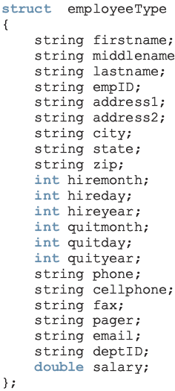
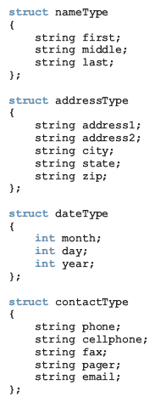
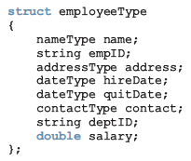
structs within a struct
versus

Slide 26
Example structs within a struct
//See Example 1.16
Notes:
See pr7-14.cpp

Slide 27
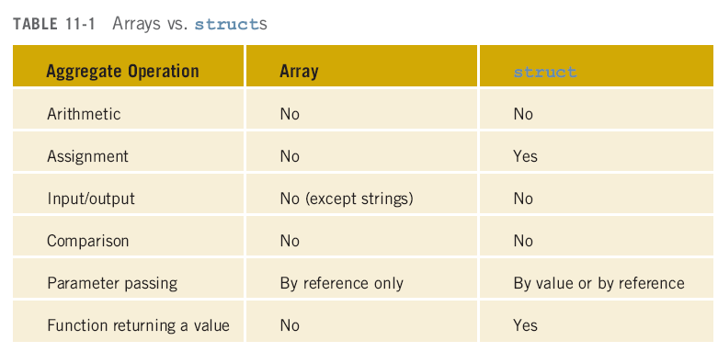
Arrays versus structs

Slide 28

Arrays in structs
Two key items are associated with a list:
Values (elements)
Length of the list
Define a struct containing both items:

Slide 29
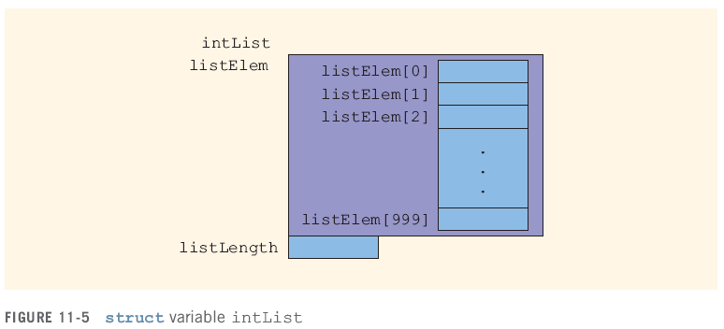
Arrays in structs

Slide 30

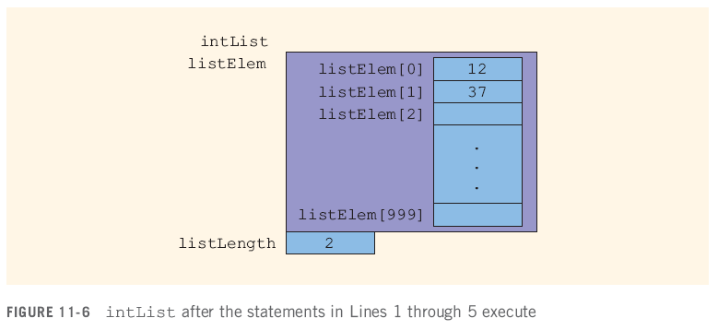
Arrays in structs

Slide 31
structs in Arrays

Slide 32
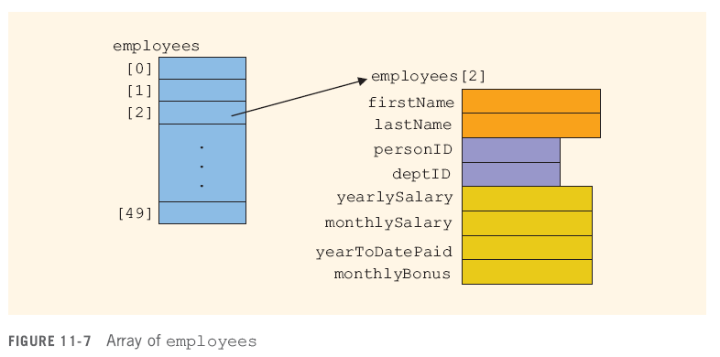
structs in Arrays

Slide 33
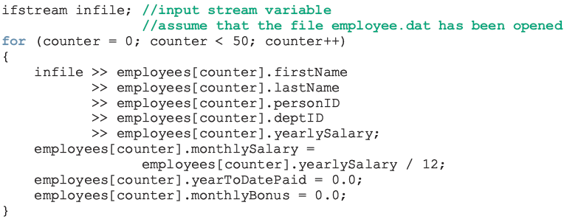
structs in Arrays

Slide 34
Example structs in Arrays
See Example 1.17

Slide 35
Pointers to Structures
Can create pointers to objects and structure variables
struct Student {…};
Student stu1;
Student *stuPtr = &stu1;
Need to use() when using * and . operators
(*stuPtr).studentID = 12204;

Slide 36
Structure Pointer Operator
Simpler notation than (*ptr).member
Use the form ptr->member:
stuPtr->studentID = 12204;
squarePtr->setSide(14);
in place of the form (*ptr).member:
(*stuPtr).studentID = 12204;
(*squarePtr).setSide(14);

Slide 37
Example of Pointers to Structures
See Example 1.18

